Slide 1

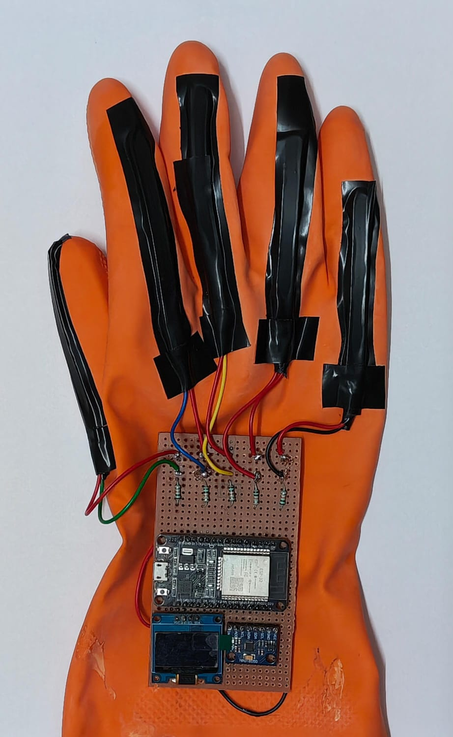
AI-Enhanced Smart Gesture Communication Glove
TEAM MEMBERS
Lingesh [ 24619119 ]
Derin Gino [ 24619107 ]
Akash [ 24619103 ]
GUIDE
Ms. N. Meenakshi

Slide 2
Abstract
Communication between sign-language users and non-signers is limited by the lack of a shared medium. This project builds an AI-enhanced smart glove that captures finger bending and hand orientation using five flex sensors and an MPU6050 IMU, read by an ESP32.
Sensor data is calibrated, filtered and converted into features for a Random Forest classifier that recognises gestures, ISL alphabets and selected ISL words. Results appear as text on an OLED display and as spoken voice, with optional Bluetooth to a mobile app.
The result is a portable, low-cost wearable that works independently of lighting and camera position.
5
Flex sensors
11
Raw sensor channels
2
Outputs: text + voice
AI-Enhanced Smart Gesture Communication Glove
2

Slide 3
Problem Statement
1
Communication barrier
“Sign language is powerful. Understanding it is not universal.”
Most people do not understand sign language, so signers depend on interpreters or writing.
2
Limits of vision-based systems
Camera approaches suffer from lighting dependency, background interference and camera positioning sensitivity.
3
Need for a practical solution
A portable, low-cost, real-time wearable that turns signs into text and voice is still needed.
AI-Enhanced Smart Gesture Communication Glove
3

Slide 4
Objectives
1
SENSE
2
RECOGNISE
3
LEARN
Capture finger bending and hand orientation using five flex sensors and an MPU6050 IMU.
Detect predefined gestures, ISL alphabets and selected ISL words using sensor fusion.
Build an ML pipeline on structured sensor datasets that generalises across users.
SENSE → PROCESS → LEARN → TRANSLATE → COMMUNICATE
4
TRANSLATE
5
ENABLE
Convert recognised signs into concise OLED text and spoken voice output.
Deliver a portable, low-cost, user-friendly wearable for everyday communication.
AI-Enhanced Smart Gesture Communication Glove
4

Slide 5
Literature Survey
# | Paper (source, year) | Approach | Key takeaway
1 | Dataglove for Sign Language Recognition — Sensors, 2023 | Flex + IMU wearable inertial sensing | Glove-based sensing is feasible for sign language
2 | ML-Based Gesture Recognition Glove — Sensors, 2024 | Gesture glove with ML recognition pipeline | Covers system design and dataset considerations
3 | MEMS and Flex Sensor-Based Recognition — IEEE Access, 2024 | MEMS IMU + flex sensors with deep learning | Temporal and spatial fusion explored
4 | Sign Language Detection Using Gloves — IJRASET, 2024 | Engineering-focused glove prototypes | Emphasises hardware–software integration
5 | Data Glove with Bending & Inertial Sensor — Electronics, 2023 | Weighted DTW fusion of bending and inertial streams | Improved temporal alignment for recognition
AI-Enhanced Smart Gesture Communication Glove
5

Slide 6
Research Gap
What existing work covers
What our project addresses
Feasibility of flex + IMU gloves for sign language
ML and deep-learning recognition, DTW sensor fusion
Prototype-level hardware–software integration
Vision-based systems affected by lighting and background
ISL alphabets and selected ISL words in one glove
Embedded, on-device recognition on a low-cost ESP32
Instant OLED text and spoken voice output
Wearable sensing that is independent of lighting and camera position
AI-Enhanced Smart Gesture Communication Glove
6

Slide 7
Existing System
Vision-based recognition
Existing glove prototypes
Camera
→
Image processing
→
Recognition
Flex and IMU gloves show that wearable sensing works for sign language
Research focuses on sensor configuration and recognition algorithms
ML, deep learning and DTW fusion have been explored
Complete embedded systems with text and voice output are less common
Lighting dependency
Background interference
Camera positioning sensitivity
Not practical for everyday, mobile use
AI-Enhanced Smart Gesture Communication Glove
7

Slide 8
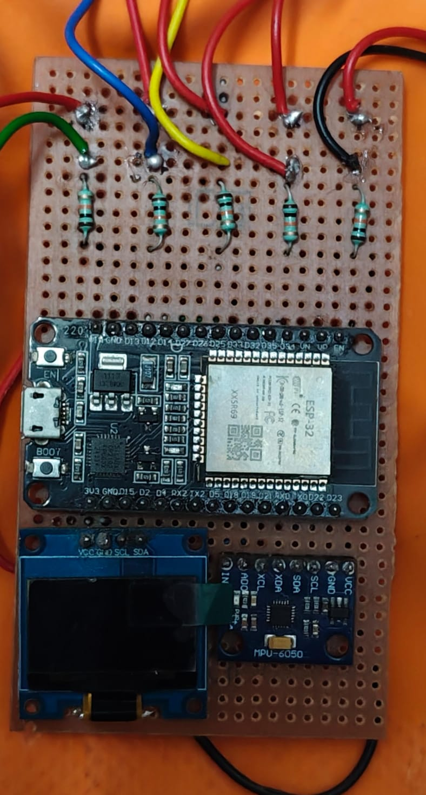
Proposed System
A wearable glove with five flex sensors and an MPU6050 IMU capturing 11 raw channels
ESP32 acquires, filters and classifies data on the device
Random Forest classifier recognises gestures, ISL alphabets and words
Output as OLED text and speaker voice, with optional Bluetooth to a mobile app
Key hardware components
SENSE
PROCESS
LEARN
TRANSLATE
COMMUNICATE
AI-Enhanced Smart Gesture Communication Glove
8

Slide 9
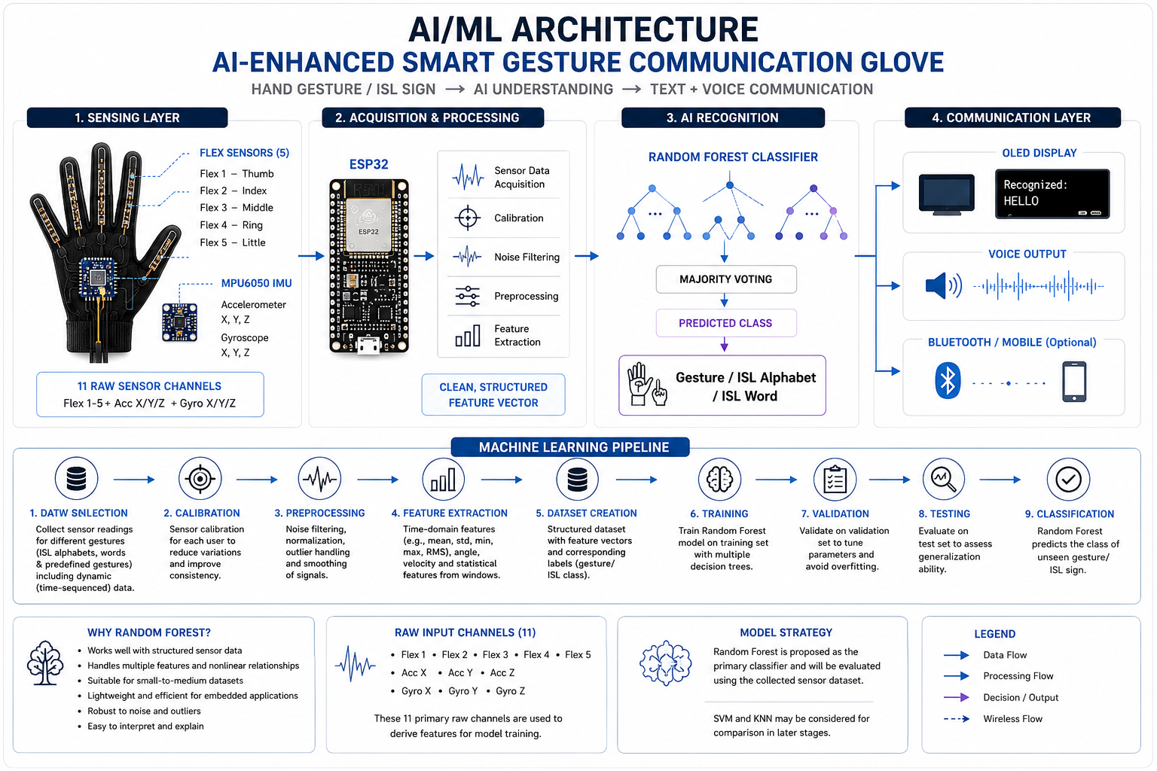
System Architecture
Sensing
5 flex sensors + MPU6050
1
Acquisition
ESP32 calibration, filtering
2
Recognition
Random Forest classifier
3
Communication
OLED, voice, Bluetooth
4
AI-Enhanced Smart Gesture Communication Glove
9

Slide 10
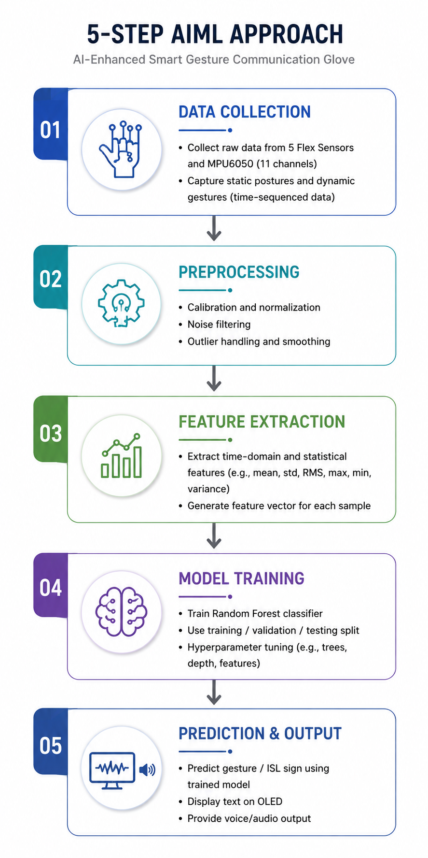
Methodology
1
Data collection
Raw readings from 5 flex sensors and MPU6050, static and dynamic gestures
2
Preprocessing
Calibration, normalisation, noise filtering, outlier handling
3
Feature extraction
Mean, std, min, max, RMS, variance into a feature vector
4
Model training
Random Forest with train / validation / test split and tuning
5
Prediction & output
Predict gesture or ISL sign, show on OLED, speak aloud
AI-Enhanced Smart Gesture Communication Glove
10

Slide 11
Technology Used
1
Hardware
2
Software
3
Machine learning
ESP32 development board
5 × flex sensors
MPU6050 (accelerometer + gyroscope)
0.96-inch OLED display
Speaker / audio output
Rechargeable battery + charging module
Resistors, PCB / breadboard
Arduino IDE
Embedded C/C++ firmware
ADC input for flex sensors
I2C for MPU6050 and OLED
Bluetooth stack for mobile link
Random Forest classifier
SVM / KNN as possible comparisons
Calibration and noise filtering
Feature extraction
Train / validation / test split
AI-Enhanced Smart Gesture Communication Glove
11

Slide 12
Data Set
11 primary raw channels per sample
Flex 1
Flex 2
Flex 3
Flex 4
Flex 5
Acc X
Acc Y
Acc Z
Gyro X
Gyro Y
Gyro Z
Collection
Preparation
Features & split
Static postures and dynamic, time-sequenced gestures covering ISL alphabets and selected words
Calibration, normalisation, noise filtering and outlier handling on every sample
Mean, std, min, max, RMS and variance per window, then train / validation / test split
AI-Enhanced Smart Gesture Communication Glove
12

Slide 13
Implementation (Modules)
1
2
3
4
5
Sensing
Acquisition
Preprocessing
Recognition
Output
Flex sensors on each finger read through voltage dividers; MPU6050 over I2C
ESP32 samples all 11 channels and applies calibration
Noise filtering, smoothing and feature extraction
Random Forest predicts the gesture or ISL sign
OLED text, speaker voice and optional Bluetooth to mobile
Data flows left to right: SENSING → ACQUISITION → PREPROCESSING → RECOGNITION → OUTPUT
AI-Enhanced Smart Gesture Communication Glove
13

Slide 14
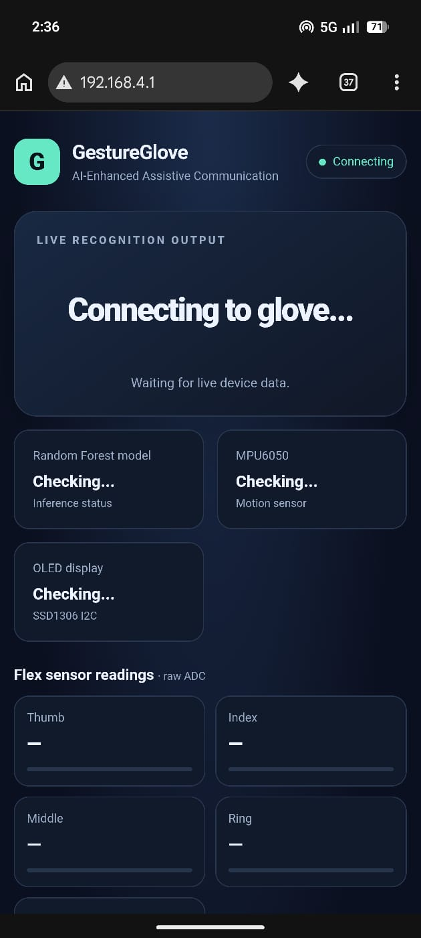
Results (Current Progress)
Paste screenshot here
Paste screenshot here
Paste screenshot here
Hardware prototype
Sensor readings
Output
Glove with ESP32, flex sensors, MPU6050
Serial monitor / plot of flex and IMU data
OLED text or recognised gesture
Current stage: Review 1 — Problem analysis and planning
AI-Enhanced Smart Gesture Communication Glove
14

Slide 15
Future Enhancement
1
Larger ISL vocabulary
2
Sentence formation
3
Mobile app
More alphabets, words and dynamic gestures
Join recognised signs into full sentences
Bluetooth companion app for display and settings
4
Advanced models
5
Multilingual voice
6
Compact design
Compare SVM / KNN and deep learning such as CNN or LSTM
Speech output in more than one language
Custom PCB and a lighter, more comfortable glove
AI-Enhanced Smart Gesture Communication Glove
15

Slide 16
Conclusion
1
The glove senses finger bending and hand motion with five flex sensors and an MPU6050.
2
An ESP32 and a Random Forest classifier turn sensor data into gestures and ISL signs.
3
Text on the OLED and spoken voice give immediate communication support.
4
The wearable approach avoids lighting and camera limits, and stays portable and low-cost.
SENSE → PROCESS → LEARN → TRANSLATE → COMMUNICATE

Slide 17
Gantt Chart (8-Week Plan)
W1
W2
W3
W4
W5
W6
W7
W8
Problem definition
Literature review & research
Hardware selection & circuit design
Sensor integration & data collection
Preprocessing & feature engineering
Random Forest model development
OLED, audio & Bluetooth integration
Testing, calibration & documentation
Current stage: Review 1 — Problem analysis and planning
AI-Enhanced Smart Gesture Communication Glove
17

Slide 18

Questions?
Lingesh · Derin Gino · Akash | Guide: Ms. N. Meenakshi

